Slide 1

Data Structures
Lecture 4: Singly Linked Lists

Slide 2

Limitations of Vectors (1)
Insert and erase functions operate in linear time ( O(n) ).
Linked Lists allow you to add or delete items anywhere (referenced) in the list in constant time ( O(1) ).
Insertion in a vector
[0] [1] [2] [3] [4] [5] [6] [7] [8] [9]
A
B
C
D
X
Y
Z
X
Y
Z
M
Insertion in a single-list
A
B
C
D
X
Y
Z
M

Slide 3
Limitations of Vectors (2)
Insert and erase functions operate in linear time ( O(n) ).
Linked Lists allow you to add or delete items anywhere (referenced) in the list in constant time ( O(1) ).
[0] [1] [2] [3] [4] [5] [6] [7] [8] [9]
Deletion in a vector
A
B
C
D
X
Y
Z
Y
Z
num_items (7)
num_items (6)
Deletion in a single-list
A
B
C
D
X
Y
Z

Slide 4
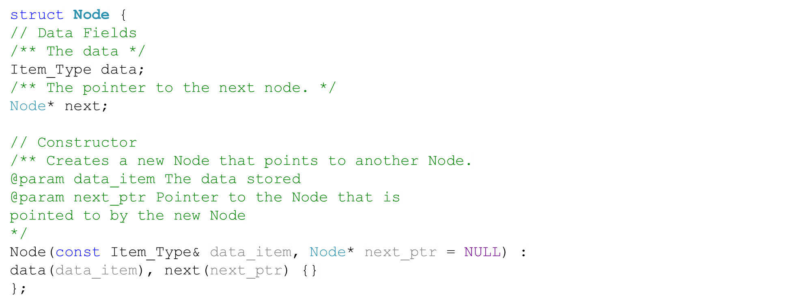
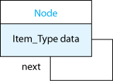
A List Node

Slide 5
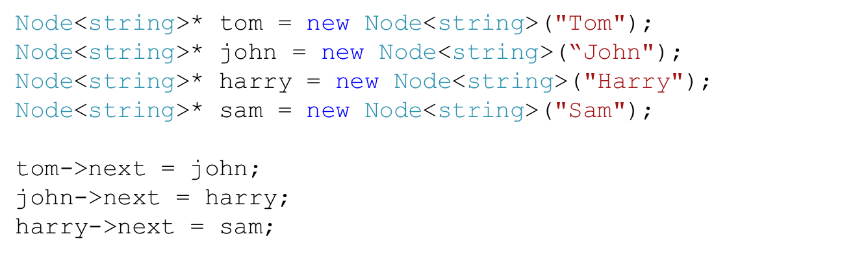

Connecting Nodes (1)
We grew the list manually.
Generally, though, we only have a reference to the head (sometimes to the tail too)
Node
Node
Node
Node
next =
data=“Tom”
next =
data=“John”
next =
data=“Harry”
next =
data=“Sam”

Slide 6
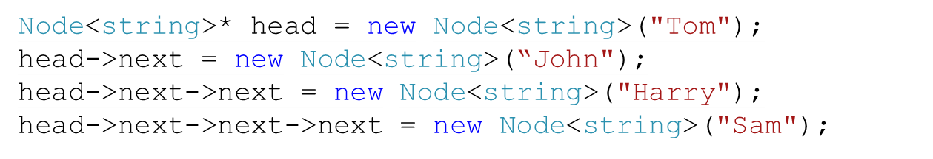
Connecting Nodes (2)
So far we grew the list by adding each node to the end of the list.
head
Node
Node
Node
Node
next =
data=“Tom”
next =
data=“John”
next =
data=“Harry”
next =
data=“Sam”

Slide 7
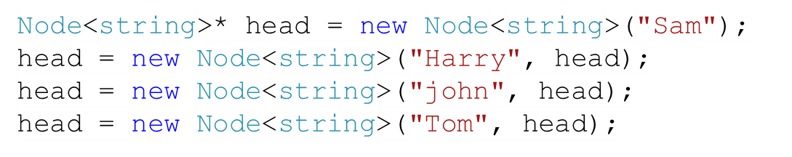
Connecting Nodes (3)
This creates the same previous list, but it is each node is added to the front.
This statement:
head = new Node(a_name, head);
has the effect of adding a new node to the front of the list.
head
head
head
head
Node
Node
Node
Node
Node
Node
Node
next =
data=“Tom”
next =
data=“Harry”
next =
data=“john”
next =
data=“Sam”
next =
data=“Sam”
next =
data=“Sam”
next =
data=“Harry”

Slide 8
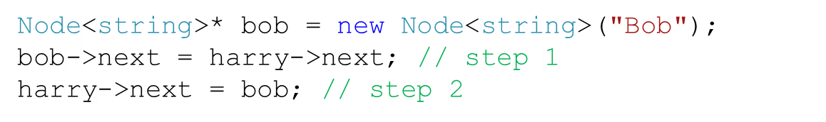

Inserting a Node in a List (1)
Can we insert a node in the list (after “Harry”) ?
Step
1
Step
2
Node
Could we have started with step 2 instead?
next =
data=“Bob”
head
Node
Node
Node
Node
next =
data=“Tom”
next =
data=“john”
next =
data=“Harry”
next =
data=“Sam”

Slide 9
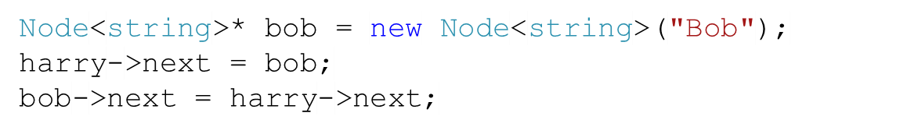
Inserting a Node in a List (2)
Could we have started with step 2 instead?
Step
2
Step
1
Node
We lost Sam, and created a circle.
However, if you save the next element (Sam) of the referenced node, then you can do it.
next =
data=“Bob”
head
Node
Node
Node
Node
next =
data=“Tom”
next =
data=“john”
next =
data=“Harry”
next =
data=“Sam”

Slide 10
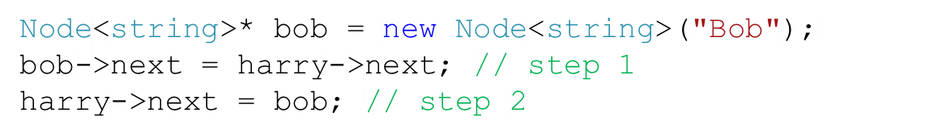
Inserting a Node in a List (3)
Can we shorten the three lines into one line?
Step
1
Step
2
Node
next =
data=“Bob”
head
Node
Node
Node
Node
next =
data=“Tom”
next =
data=“john”
next =
data=“Harry”
next =
data=“Sam”

Slide 11
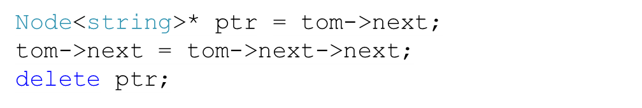
Removing a Node
We can also remove a node (“john”) after a node that we have a reference to (“Tom”)
ptr
Node
Node
Node
Node
next =
data=“Tom”
next =
data=“john”
next =
data=“Harry”
next =
data=“Sam”

Slide 12
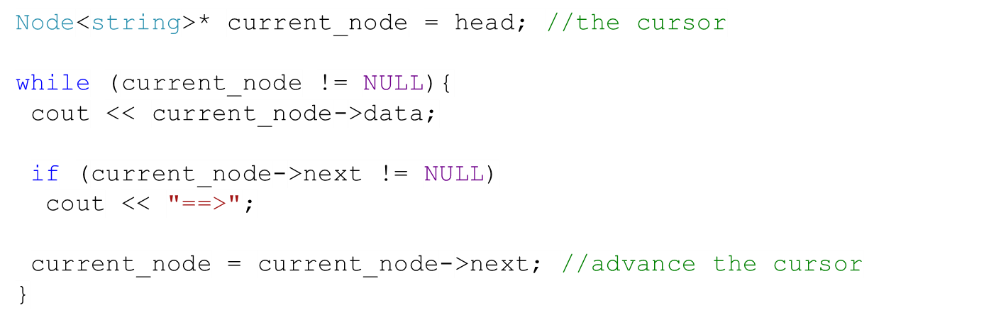
Traversing a Linked List
Tom
==>
john
==>
Harry
==>
Sam
Traversing backward is not possible.
head
Node
Node
Node
Node
next =
data=“Tom”
next =
data=“john”
next =
data=“Harry”
next =
data=“Sam”
Notes:
A common mistake is to use head instead of current_node

Slide 13

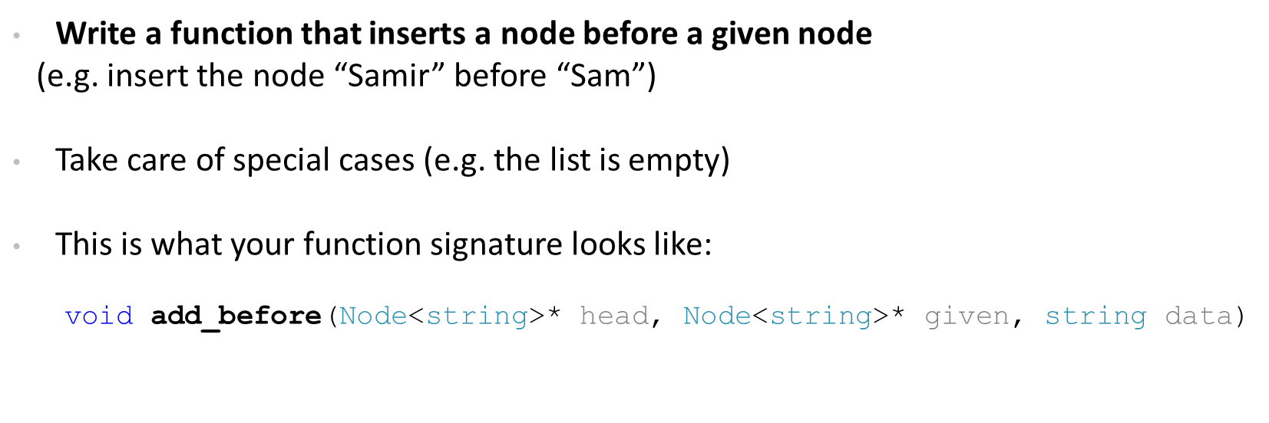
Task (1)
Not in the book
Node
next =
data=“Samir”
head
Node
Node
Node
Node
next =
data=“Tom”
next =
data=“john”
next =
data=“Harry”
next =
data=“Sam”

Slide 14
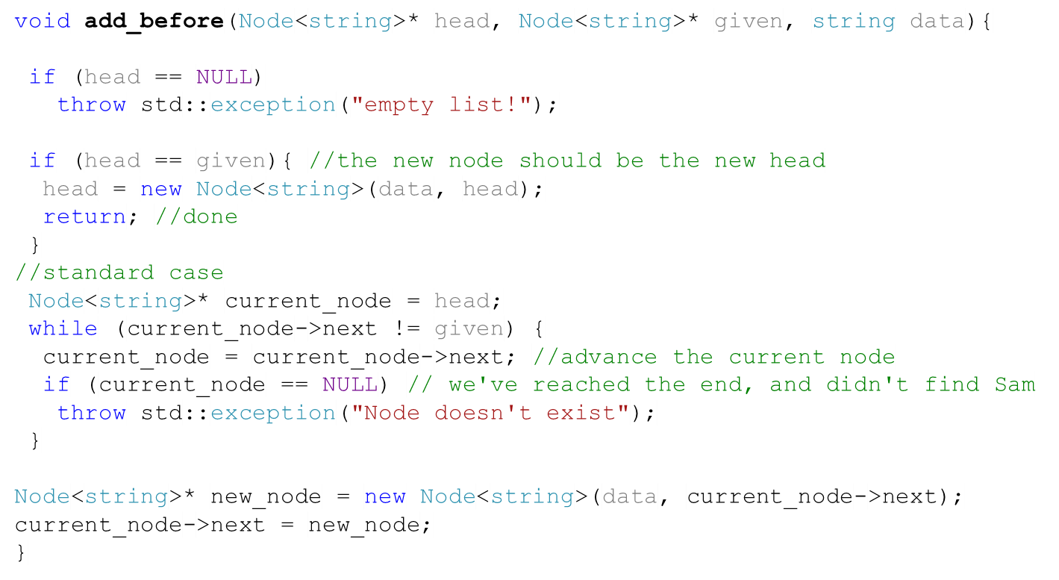
Solution
Not in the book
Node
next =
data=“Samir”
head
Node
Node
Node
Node
next =
data=“Tom”
next =
data=“john”
next =
data=“Harry”
next =
data=“Sam”

Slide 15

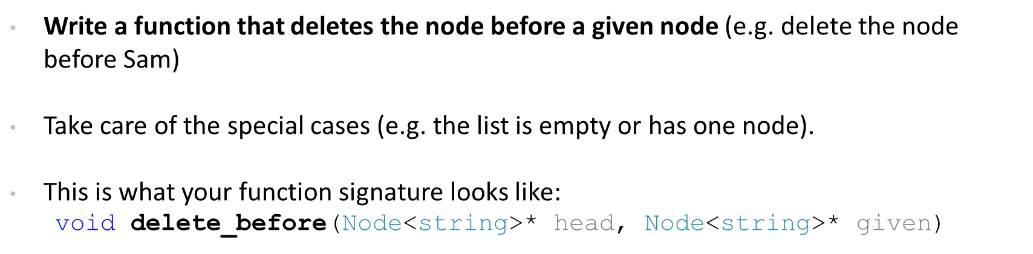
Task (2)
Not in the book
head
to_be_deleted
Node
Node
Node
Node
next =
data=“Tom”
next =
data=“john”
next =
data=“Harry”
next =
data=“Sam”

Slide 16
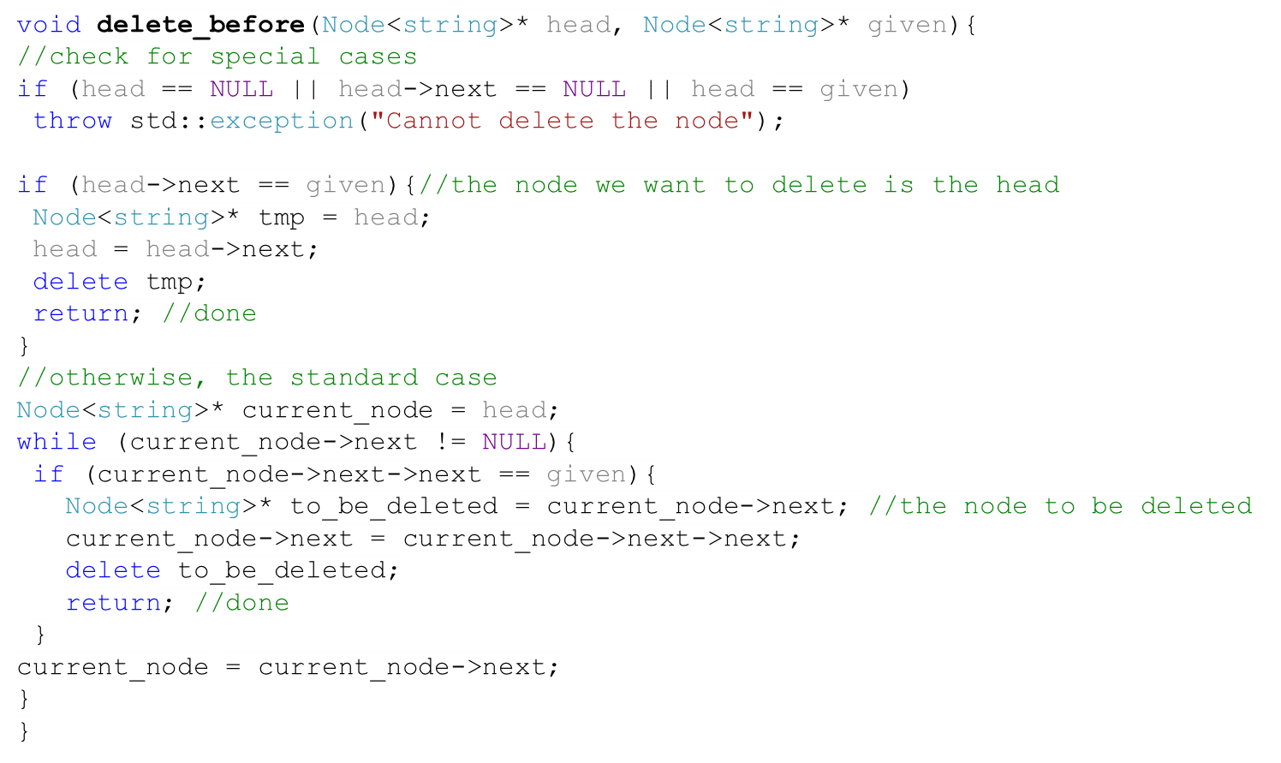
Solution
Not in the book
to_be_deleted
Node
Node
Node
Node
head
next =
data=“Tom”
next =
data=“john”
next =
data=“Harry”
next =
data=“Sam”

Slide 17
Performance of Singly-Linked Lists
It is O(1) to insert a node after a referenced node.
It is O(1) to remove a node after a referenced node.
It is O(n) (on average) to insert a node before a referenced node.
It is O(n) (on average) to remove a node before a referenced node.

